Slide 1
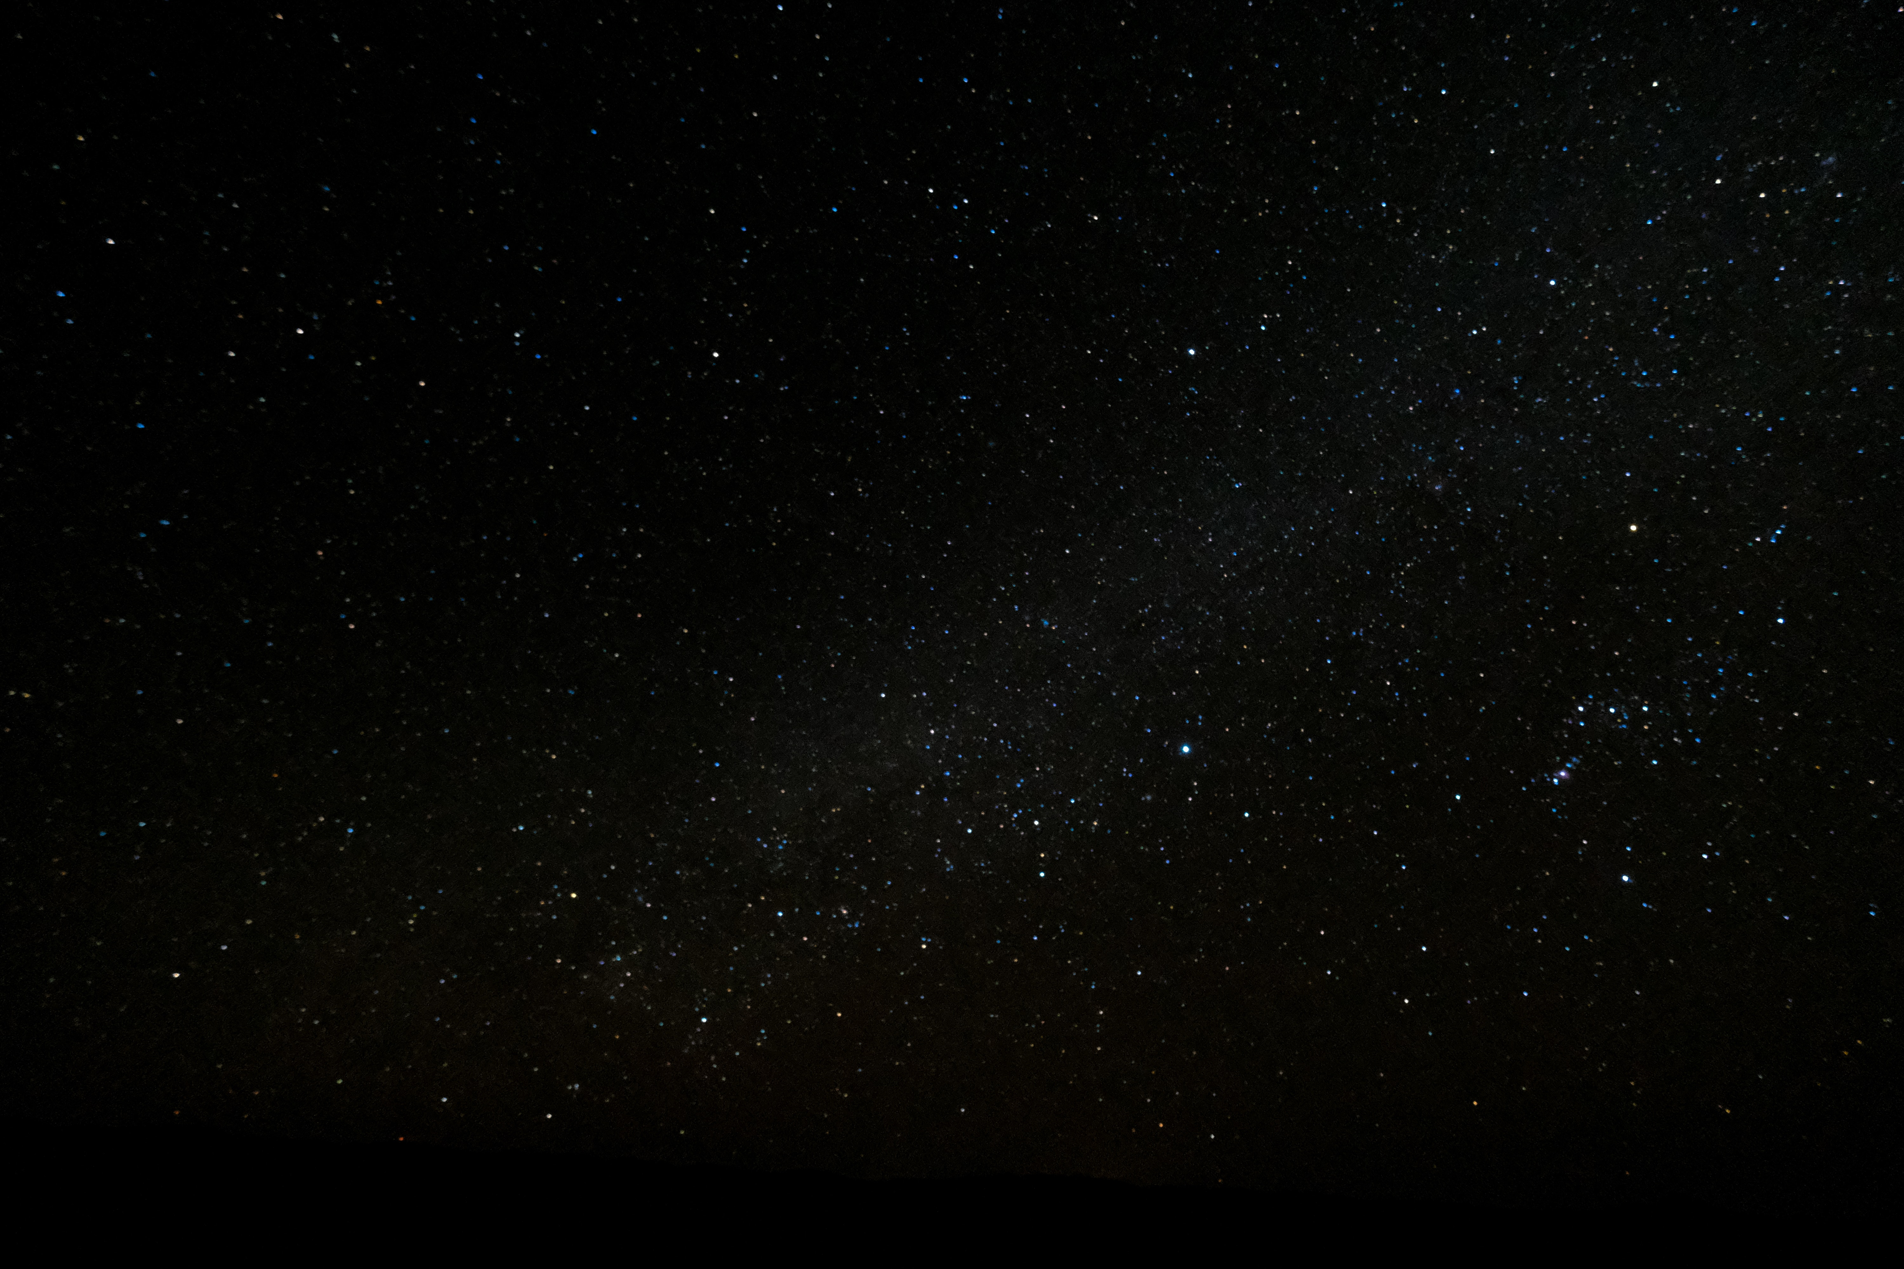
SUPER MOVIES MANAGER
FEEL LIKE THE STARS
CREATED BY EHAB, MARCELA AND IBRAHIM

Slide 2
About us
At first we weren't sure what we wanted to do, but as a group of three we thought we should do something amazing.
We believe that we have learned a lot from this experience with respect to coding and teamwork.

Slide 3
Purpose
The purpose of this application is to allow people to access an updated movie database, so they can rate the films.

Slide 4
How to use it
To use this application you must create an account, then you can access the database where you can search for movies by name or popularity.

Slide 5
Problems and Mistakes
We didn't make a to-do list
We had no idea what the API was like
We didn't have a good organization
Many problems to merge

Slide 6
Future plans for the site
We would like to improve the interactivity of the site.

Slide 7
DEMO

Slide 8
Thank you :)

